Slide 1
Techniques for Supressing Grating Lobes
Walt Deyzel
21750793
Supervisor Mr. Lanche Grootboom

Slide 2
Introduction
Antennas are designed to radiate Electromagnetic energy.
Data is encoded within electromagnetic waves and transmitted over long distances.
Two methods of steering is possible: Mechanical steering & Phased arrays.

Slide 3
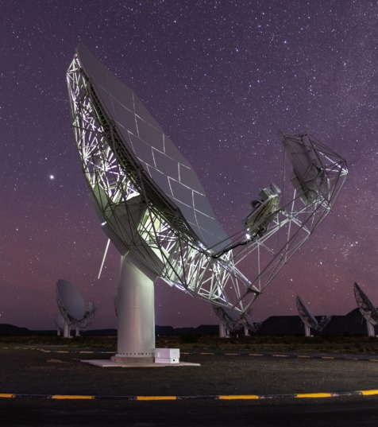
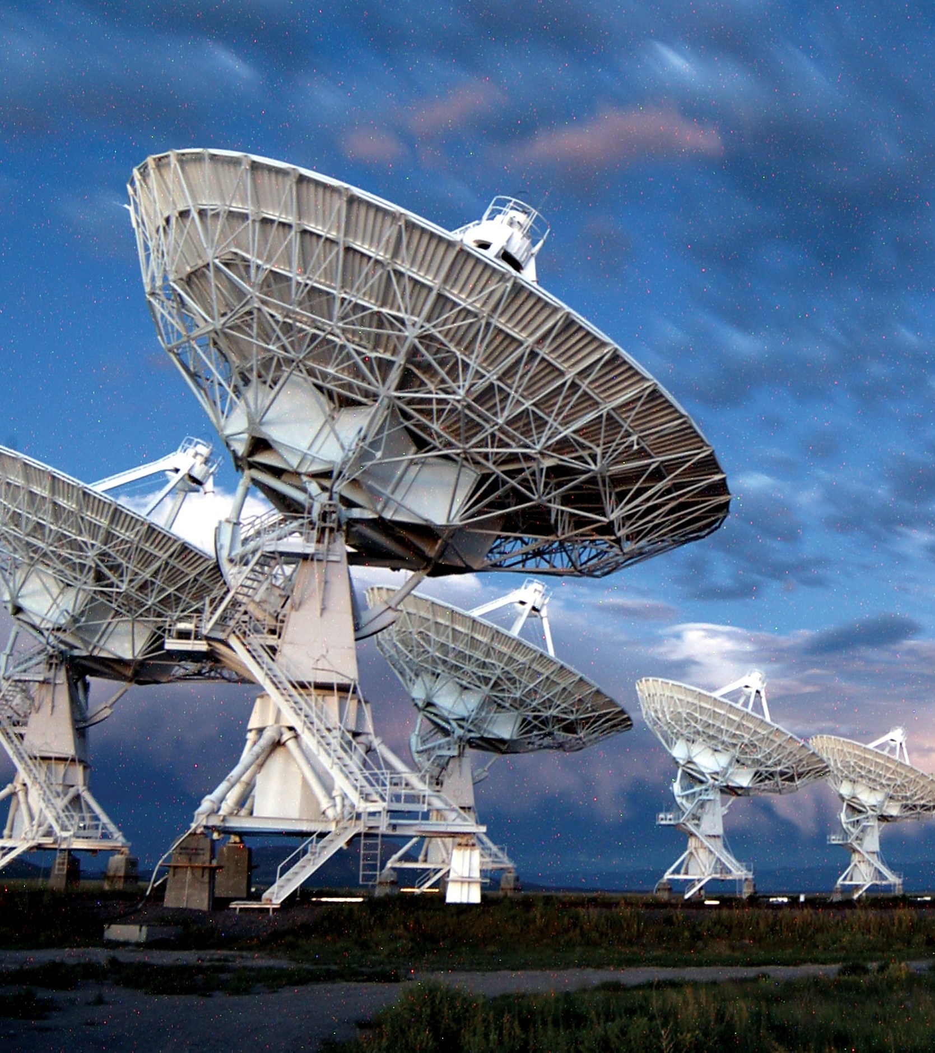
MeerKAT radio telescope array
located in the Northern Cape
National Radio Astronomy Observatory located west of Socorro, New Mexico

Slide 4
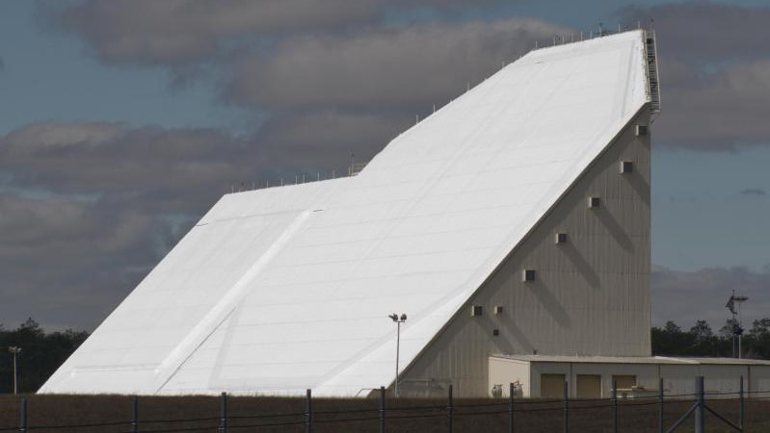
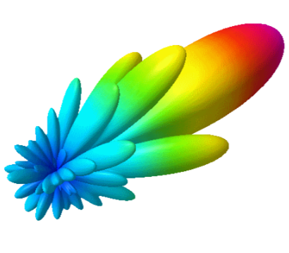

Slide 5
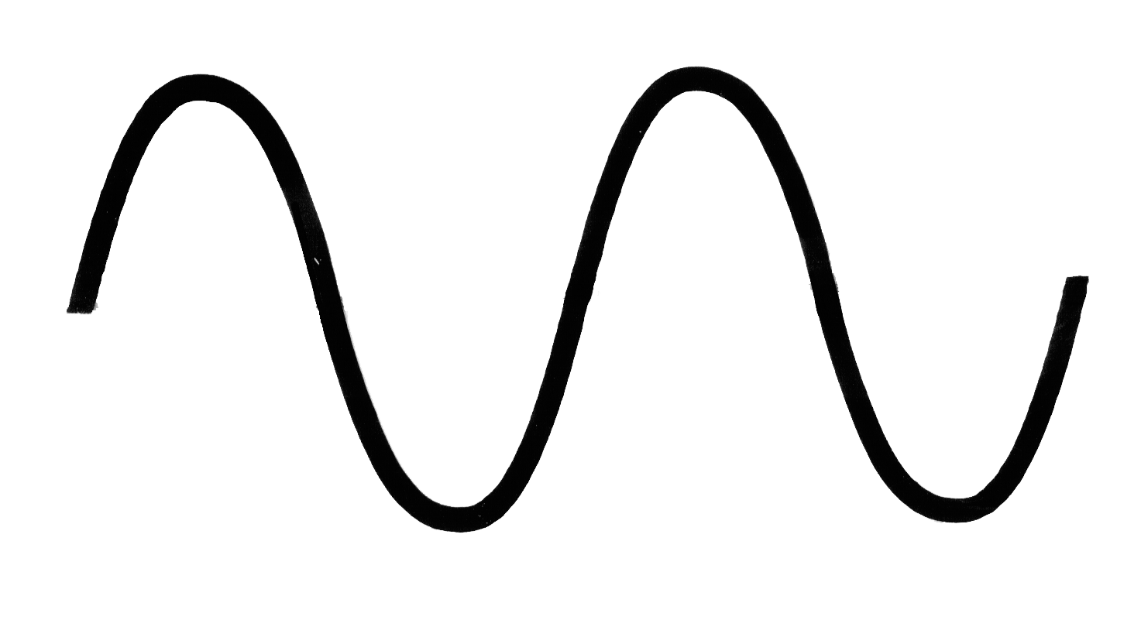
In the simplest form, an antenna can be modelled as a point source radiating in all directions at a particular frequency. These point source antennas are known as omnidirectional antennas.
Point source antenna
Wavelength:
λ
c
Speed of light:
Operating frequency: f
c = f λ

Slide 6
The antennas can be arranged in a Linear Antenna Array (LAA).
This improves the overall power gain and improves the directivity.
Constructive Interference
Deconstructive Interference
k λ
This means the electromagnetic energy can be transmitted further and more effectively.

Slide 7
Problem Statement
This project investigated how the:
Position of each antenna element.
phase shift of the signal of each antenna element.
amplitude of the signal of each antenna element.
In an LAA affect grating lobes and how these parameters should be optimized to suppress the grating lobes.

Slide 8
Objective
The aim is to find a fixed element spacing and the resulting phase shift and amplitude distribution for the LAA that allow for the suppression of grating lobes.
Performance is measured relative to a uniform LAA of half a wavelength.
These parameters will be obtained by deploying a Genetic Algorithm.
Grating lobes must be suppressed while keeping an acceptable HPBW and SLL.

Slide 9

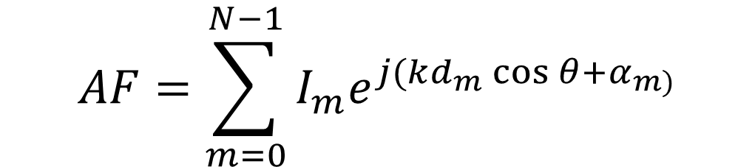
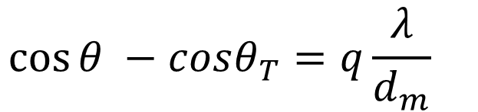

Array Factor (AF)
Number of antennas: N
Altering ${ α}_{m}$ allows for beam steering.
$$AF=\sum_{m=0}^{N−1}{I_{m}e^{j(kd_{m}\cos{θ+α_{m)}}}}$$
$$\cos{θ −cosθ_{T}=q\frac{λ}{d_{m}} }$$
Note $|cos{θ}| ≤1$
Therefore $\left[0° ≤ θ ≤180°\right]$or $\left[−180° ≤ θ ≤ 0°\right]$
This is knows as the visible region

Slide 10
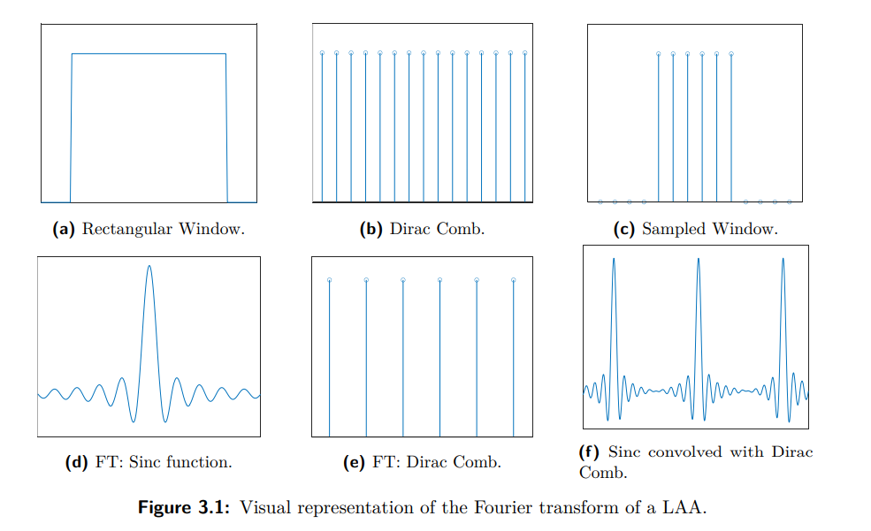

Fourier Transform and the AF:
$$DFT=\sum_{n=0}^{N−1}{x(n)e^{−j(\frac{2πkn}{N})}}$$
N
d
d
$$\frac{λ}{d}$$
$$\frac{λ}{d}$$

Slide 11


Grating Lobes
Grating lobes are unwanted secondary main lobes.
They are wasted energy and decrease the efficiency of the antenna array.
No grating lobes
Two grating lobes
Four grating lobes.
At $0°$and $180°$
At $0°$, $60°$ ,$120°$and $180°$

Slide 12


Phased Arrays: Steering
$$α_{m}=−kd_{m}\cos{θ_{T}}$$
$$Δγ= \frac{360 d \sin{θ_{T}}}{λ}$$

Slide 13





Array Geometry
d
d
d
d
d
Uniform LAA
$$d_{1}$$
$$d_{2}$$
$$d_{3}$$
$$d_{2}$$
$$d_{1}$$
Non-uniform LAA
Symmetrical around the mean

Slide 14
Genetic Algorithm
Generate a population of N random solutions.
While current generation != maximum generations
Assign a fitness/error score to each solution.
Select solutions from the population.
Tournament selection method.
Generate offspring (new solution).
Crossover and Mutation techniques.
Next generation.
Immediately copy over fittest solution from the previous generation.

Slide 15

Fitness Score
$$D_{0}= \frac{{π|{AF}_{max}|}^{2}}{\int_{0}^{π}{AF} dθ}$$
$$F_{0}= \frac{\sum_{0}^{π}{AF(θ)}}{{AF(θ_{T})}^{2}}$$
Directivity function
Fitness function

Slide 16
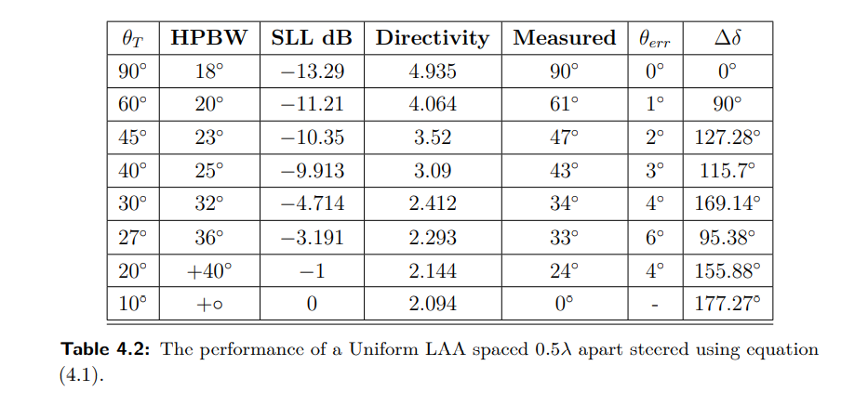
Uniform LAA

Slide 17

GA vs beam steering equation.
GA: 7.75% fitter
GA: 1.42% fitter
$$AF=\sum_{m=0}^{N−1}{I_{m}e^{jγ_{m}}}$$
$$Δγ= \frac{360 d \sin{θ_{T}}}{λ}$$
GA: 0.36% fitter
GA: 0.005% less fit

Slide 18
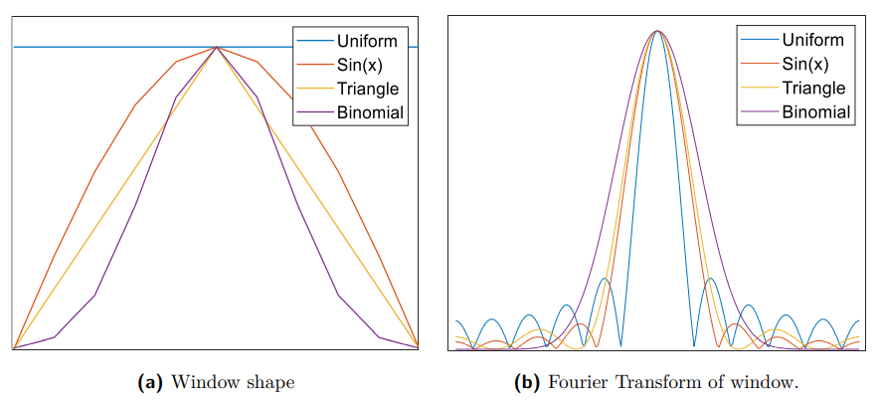
Optimizing Amplitude distribution.
Distribution | SLL (dB)
Uniform | -13.29
Dolph-Chebyshev | -30
Binomial | -55
GA | -34.7
21.21 dB (159.59%) reduction in SLL

Slide 19
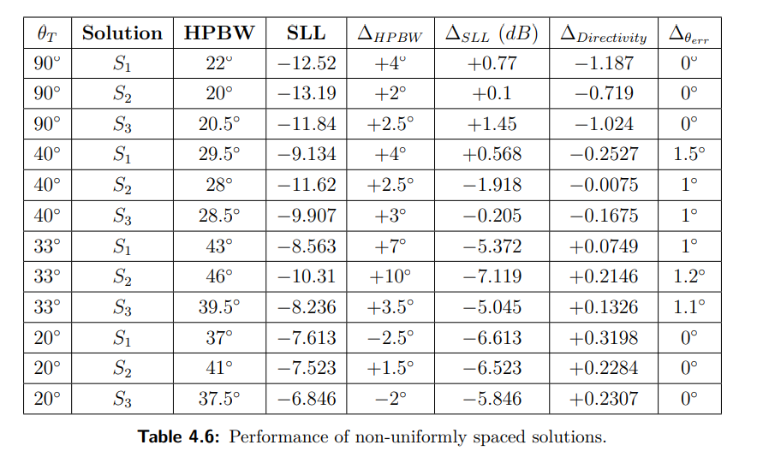
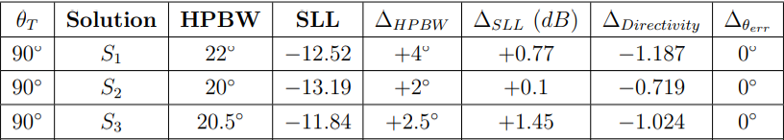
Non-Uniform spaced LAA vs Uniform LAA

Slide 20


Non-Uniform spaced LAA vs Uniform LAA
$$−5.85 dB$$
$$−5.05 dB$$

Slide 21
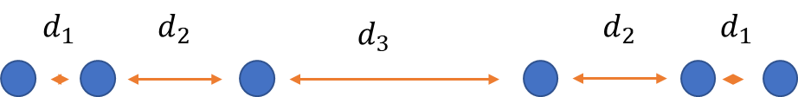
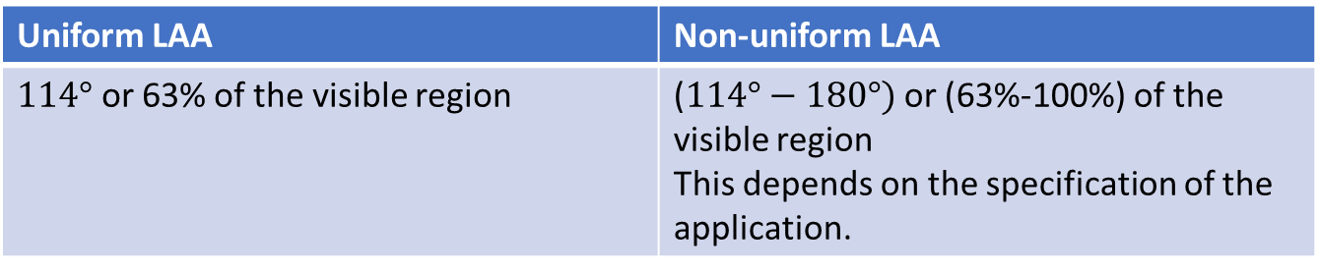
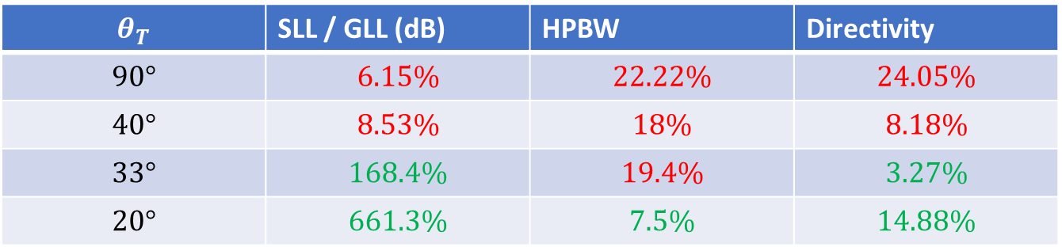

Results
Solution 1 vs Uniform LAA
$S_{1}$= [ 0.3, 0.475, 0.52, 0.475, 0.3]
$$θ_{T}$$ | SLL / GLL (dB) | HPBW | Directivity
$$90°$$ | $$6.15\%$$ | $$22.22\%$$ | $$24.05\%$$
$$40°$$ | $$8.53\%$$ | $$18\%$$ | $$8.18\%$$
$$33°$$ | $$168.4\%$$ | $$19.4\%$$ | $$3.27\%$$
$$20°$$ | $$661.3\%$$ | $$7.5\%$$ | $$14.88\%$$
Steering range
Uniform LAA | Non-uniform LAA
$114°$ or 63% of the visible region | ($114°−180°)$ or (63%-100%) of the visible region This depends on the specification of the application.
There is a trade off between the SLL, HPBW and directivity.

Slide 22
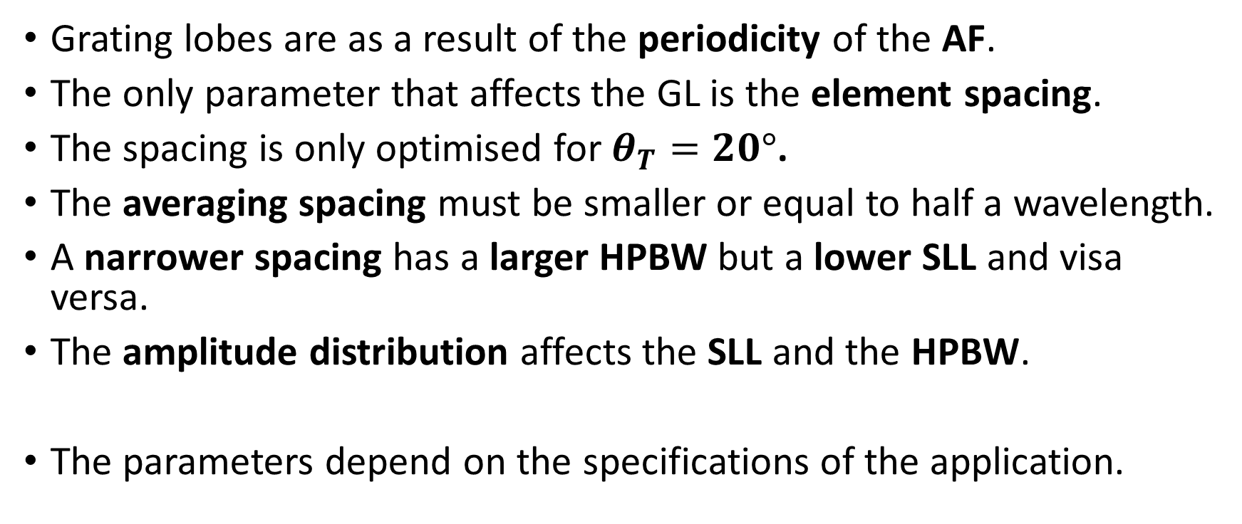
Conclusion
Grating lobes are as a result of the periodicity of the AF.
The only parameter that affects the GL is the element spacing.
The spacing is only optimised for $θ_{T}=20°$.
The averaging spacing must be smaller or equal to half a wavelength.
A narrower spacing has a larger HPBW but a lower SLL and visa versa.
The amplitude distribution affects the SLL and the HPBW.
The parameters depend on the specifications of the application.

